Slide 1
Final Presentation
Siheng Chen, Xinyi Li, Yifan Zhu, Zexi Luo

Slide 2
Table of content
Project overview
Brief related work
Key user research findings
Prototype evolution
Key final user evaluation results
Lessons learned
Future work
Highlighting contributions

Slide 3
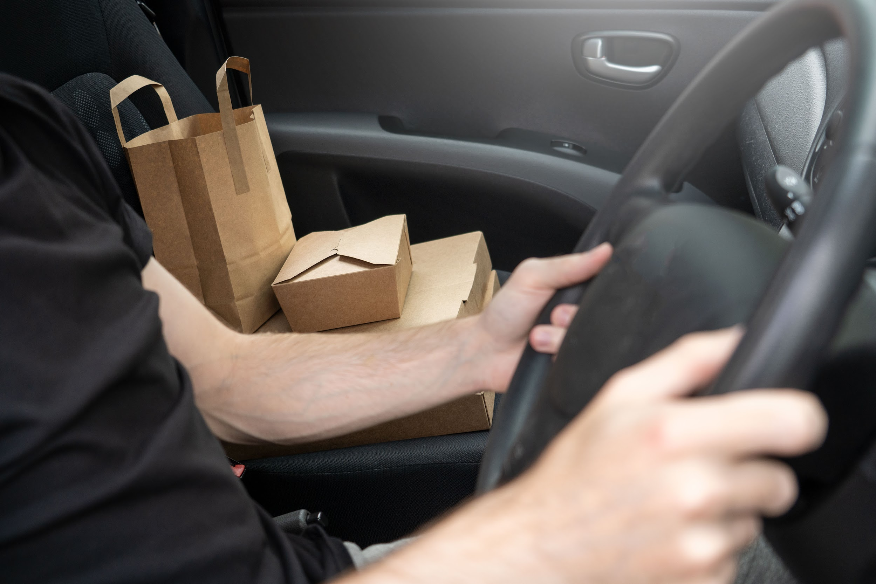

Project overview
Problem:
Campus food delivery services face unique challenges
Drivers struggle with finding buildings and waiting for clients
Ineffective communication and inaccurate navigation software
Motivation:
Increase income for drivers and platforms by reducing time spent
Improve mental and physical health of students
Promote contactless delivery for privacy and health protection
Solution:
Develop an app using robotic carriers as distributors for food delivery
Establish distribution centers with robotic carriers on standby

Slide 4
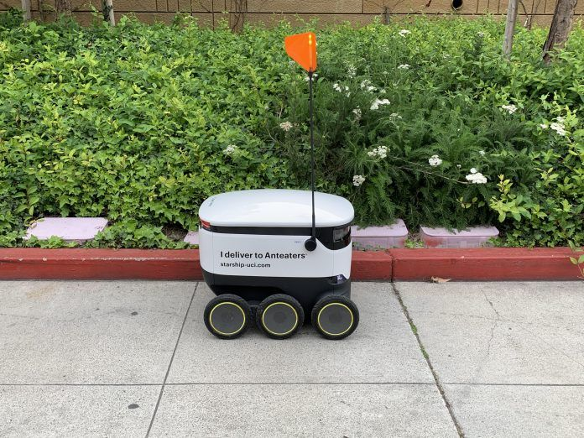

Brief related work
Conducted research on current existing system(UCI remote control campus delivery bot)
Assessed the practicality of this design from both user and third-part delivery platform driver perspective
Taken our members and friends’ past on-campus food delivery order experiences into account

Slide 5


Key user research findings
Participants:
Targeting students, staff, and delivery workers at the UVic
8 diverse volunteers (students, staffs, delivery drivers)
Research Methods:
Interviews: face-to-face, semi-structured conversations on campus
Ethnography: observing the delivery process from start to finish
Timestamped the delivery process for insights

Slide 6
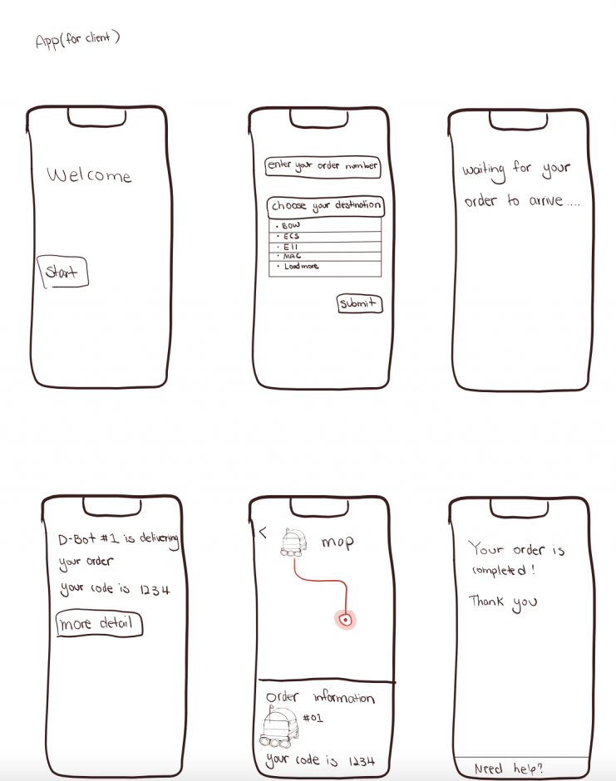
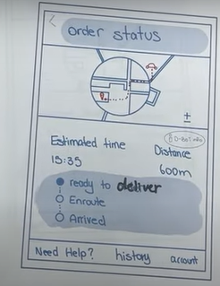
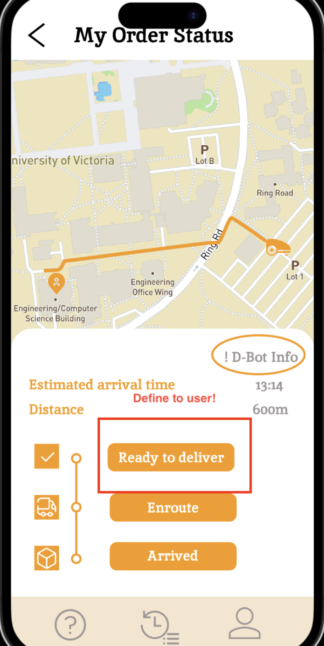
Prototype evolution

Slide 7
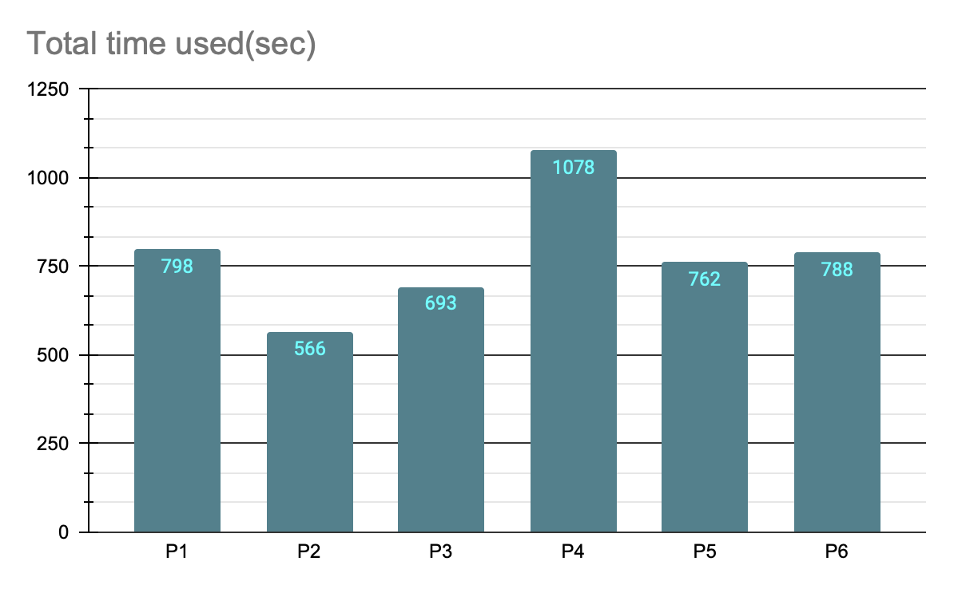
Total time spent
The average total time spent by users was 780 seconds with a minimum of 566 seconds and a maximum of 1078 seconds. These findings suggest that users may have different levels of proficiency or interest in each task, which can be further explored and investigated to improve user engagement and task completion rates.

Slide 8
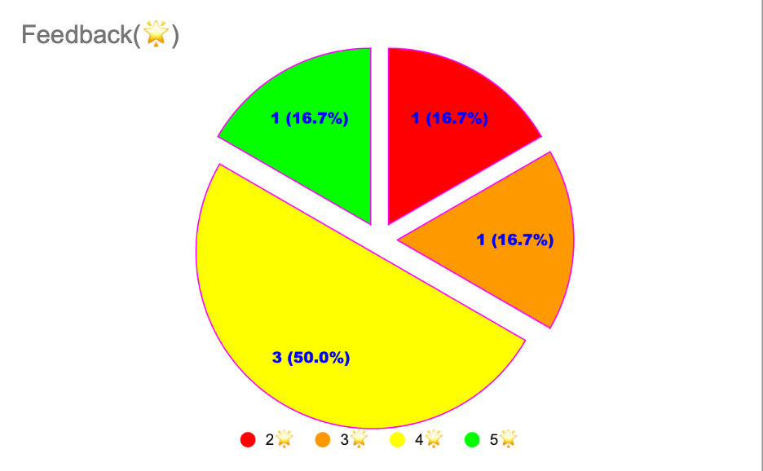
Feedback
3(50%) of users rated our app 4 stars and the other three(16.7% * 3) gave us 2, 3, 5 stars respectively. This suggests that the app received mixed reviews from users, with some finding satisfactory and others having more varied opinions. Further analysis and feedback from users may be needed to identify areas for improvement and enhance overall user satisfaction.

Slide 9
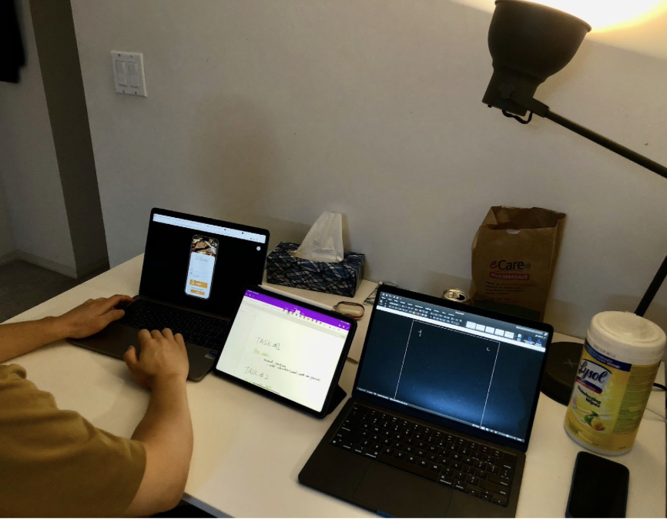
Key final user evaluation results
Relatively positive feedback for app's mid-fidelity prototype.
Anonymity/information security.
Potential to improve customer experience.
Limitations due to objective environmental constraints.

Slide 10

Lessons learned
Functional and technically sound system + end-users’ experiences
Imprtance of user reashe and usability test
Teamwork
Notes:
As developers, we are often focused on creating a functional and technically sound system. However, it is important to remember that the end-users are the ones who will ultimately use the system. Without considering their needs and preferences, our system will not be user-friendly, leading to frustration and a poor user experience.
We learn that user research involves understanding the needs and preferences of the end-users through surveys, interviews, and focus groups. Usability testing involves observing users interacting with the system to identify areas of confusion or frustration. By conducting these activities, we gain insights into the user's intuitive thinking, which helps us design a system that is both technically sound and user-friendly.
In addition to user-centric design, teamwork and effective communication are also essential for project success. Efficiency communication can avoid misunderstandings and ensure that everyone is on the same page. It also fosters creativity and collaboration, allowing team members to build on each other's ideas.
When assigning tasks, it is important to consider each team member's skills, experience, and interests. This helps ensure that the task is a good fit for all group members abilities and the team can work more efficiently and effectively.
By leveraging these factors, we can create a system that not only meets the technical requirements but also provides a positive user experience.

Slide 11
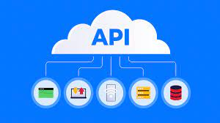

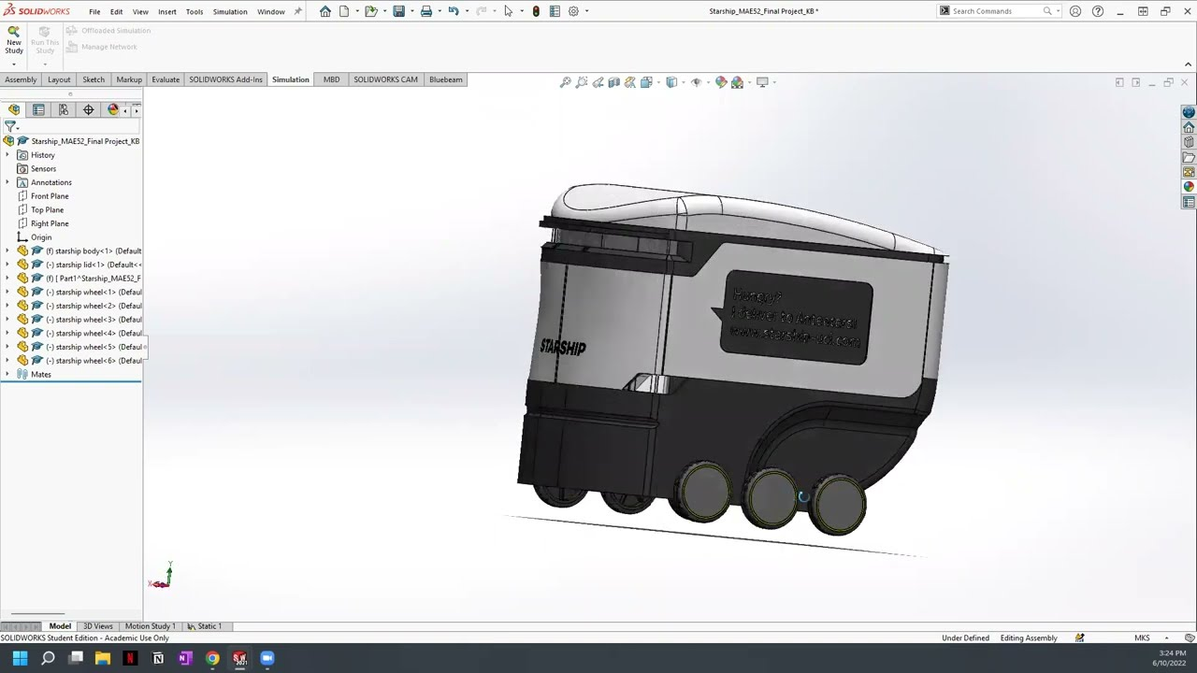


Future work
Implementation of the software
Design the hardware aspects–the robotic carrier(solidworks), dispatch station
conduct with mechanical experts
Conduct with food delivery platforms to develop an efficient way of link their platforms to our APP
Seek more comprehensive user samples for our usability testing to acquire more concise feedback

Slide 12
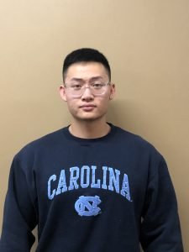
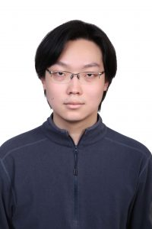
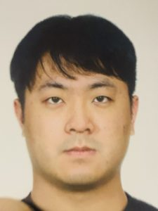
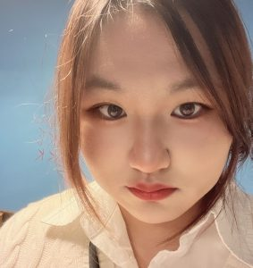
Highlighting contributions
Each of the four members plays a vital and integral role in our project. Our members, in their various tasks, make the most of their individual strengths. In particular, Siheng have taken the initiative on the role of leader in the project, demonstrating a strong sense of responsibility and leadership.

Slide 13
Questions?
Siheng Chen, Xinyi Li, Yifan Zhu, Zexi Luo

Slide 14
Thank you
Siheng Chen, Xinyi Li, Yifan Zhu, Zexi Luo

